Slide 1
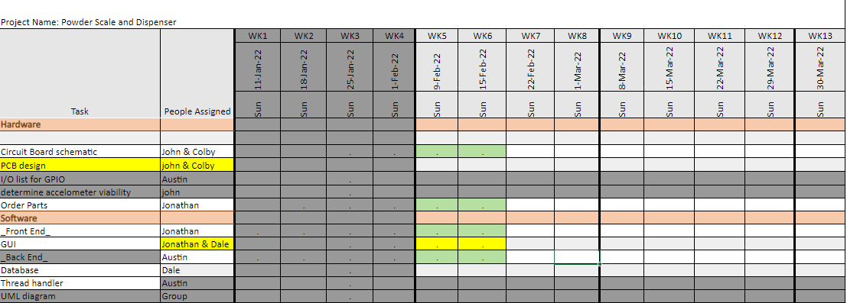
Week 5 (2-Feb to 8-Feb)

Slide 2
Week 5 (2-Feb to 8-Feb) Austin Stecklein
Goal/Task | % Done | Hours (Act.)
Investigating hardware | 100 | 3
Finish database | 99 | 4
Backend events | 75 | 6
Hours on task during the week (On track ≥ 13 / wk) | 13
Total hours on task so far this semester (On track ≥ 62 hrs) | 56

Slide 3
Progress made during the week (Log) (What I did)
Found that voltage regular to be the problem. Will take these lessons learned for future hardware
Finish database and interface for the GUI.
Continued to work on the PID and physical events.

Slide 4
Difficulties encountered during the week (What I did not do and why)
None

Slide 5
Goals for this coming week (Ones that move the project forward the most)
Goal/Task | Stop Date (Est.) | Hours (Est.)
Finish backend events and start testing them with replacement beagle bone (lower voltage this time) | 2/16/2021 | 6
Finish PID and start experimenting with finding the best coefficients | 2/16/2021 | 5
Start merging GUI and backend | 2/16/2021 | 4
Estimated time needed to work on goals for this coming week (typ. 13 hrs) | 15

Slide 6
Week 5 (2-Feb to 8-Feb) John Stinger
Goal/Task | % Done | Hours (Act.)
Continue to work on the board schematic |  | 4
Continue to work on the board layout |  | 4
Other |  | 4
Hours on task during the week (On track ≥ 13 / wk) | 12
Total hours on task so far this semester (On track ≥ 62 hrs) | 51

Slide 7
Progress made during the week (Log) (What I did)
Board development
Found different connectors
Started testing speakers

Slide 8
Difficulties encountered during the week (What I did not do and why)
none

Slide 9
Goals for this coming week (Ones that move the project forward the most)
Goal/Task | Stop Date (Est.) | Hours (Est.)
Continued Development of the board | Ongoing | 7
Research how to design better board drivers |  | 3
Estimated time needed to work on goals for this coming week (typ. 13 hrs) | 12

Slide 10
How can we help you achieve your goals?
Continued Support

Slide 11
Week 5 (2-Feb to 8-Feb) Colby Hatton
Goal/Task | % Done | Hours (Act.)
Schematic Work | 85% | 10
Layout | 5% | 1
Parts/Resarch/Testing | 80% | 2
Hours on task during the week (On track ≥ 13 / wk)
Total hours on task so far this semester (On track ≥ 62 hrs) | 51

Slide 12
Progress made during the week (Log) (What I did)
Preformed MicroSD boot, verified speaker arrangement, prepared pin layout

Slide 13
Difficulties encountered during the week (What I did not do and why)
Finding a good motor driver

Slide 14
Goals for this coming week (Ones that move the project forward the most)
Goal/Task | Stop Date (Est.) | Hours (Est.)
Obtain Motor Driver | Ongoing | 13
Finish Schematic
Contuine Layout
Estimated time needed to work on goals for this coming week (typ. 13 hrs) | 13

Slide 15
How can we help you achieve your goals?
Continued Support, consistently updated line/signal list

Slide 16
Week 5 (3-Feb to 9-Feb) Dale Andreoli
Goal/Task | % Done | Hours (Act.)
Find or create a touch keyboard module to slot into the GUI | 80% | 5
Collaborate with Jonathan and Austin on GUI implementation |  | 9
Project Objective / Mission Statements
Power Scale Dispenser:
Design, build, and test the electronics for the dispenser with a touch screen display and controlling two stepper motors by April 6, 2021 with a prototyping budget of $1000 USD and for less than 600 people-hours.
Hours on task during the week | 14
Total hours on task so far this semester | 56

Slide 17
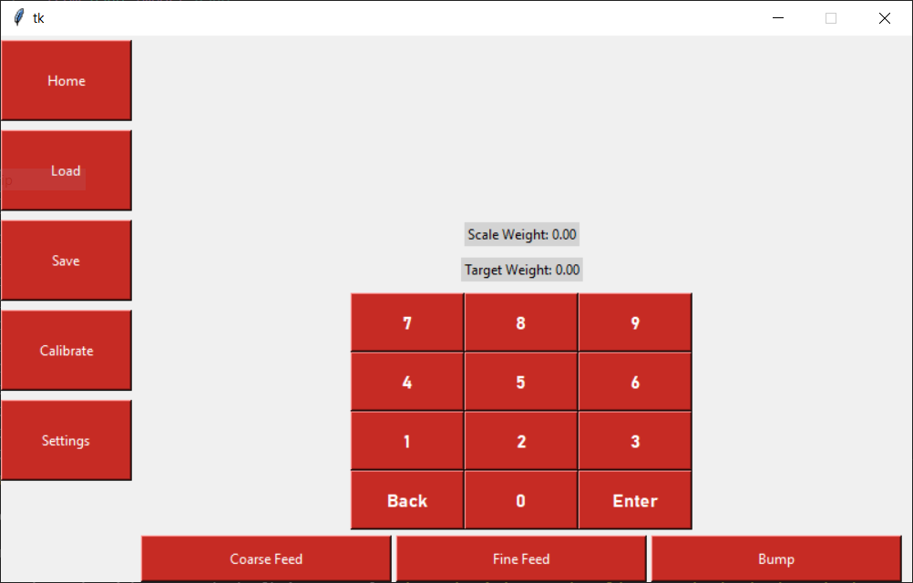
Progress made during the week (Log) (What I did)
Found a keyboard that should suit our needs after some modification
Refactored some of the GUI code to better apply principles of abstraction
Collaborated with Jonathan and Austin on GUI implementation

Slide 18
Difficulties encountered during the week (What I did not do and why)
Jonathan and I were getting some errors from the library as we tried to put the GUI code into different files

Slide 19
Goals for this coming week (Ones that move the project forward the most)
Goal/Task | Stop Date (Est.) | Hours (Est.)
Finish implementing the keyboard |  | 3
Collaborate with Jonathan and Austin on what GUI pages to implement next |  | 9
Estimated time needed to work on goals for this coming week | 12

Slide 20
Week 5 (2-Feb to 8-Feb) Jonathan Phillips
Goal/Task | % Done | Hours (Act.)
Front End | Ongoing | 11
Hours on task during the week (On track ≥ 13 / wk) | 11
Total hours on task so far this semester (On track ≥ 62 hrs) | 51

Slide 21
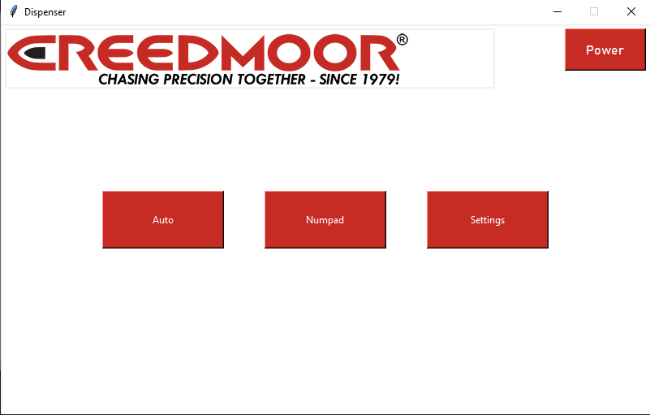
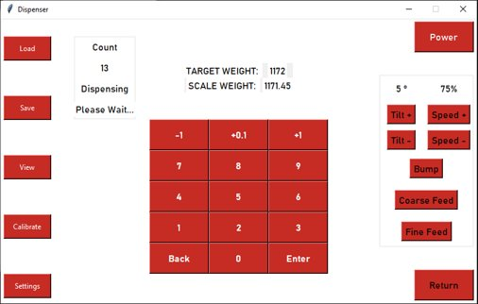
Progress made during the week (Log) (What I did)

Slide 22
Difficulties encountered during the week (What I did not do and why)
Python doesn’t like circular imports

Slide 23
Goals for this coming week (Ones that move the project forward the most)
Goal/Task | Stop Date (Est.) | Hours (Est.)
Front End | Ongoing | 13
Estimated time needed to work on goals for this coming week (typ. 13 hrs) | 13

Slide 24
How can we help you achieve your goals?
Continued Support

